Slide 1

Twitter Keyword Search
Mingdao Che
Zhibin Huang

Slide 2
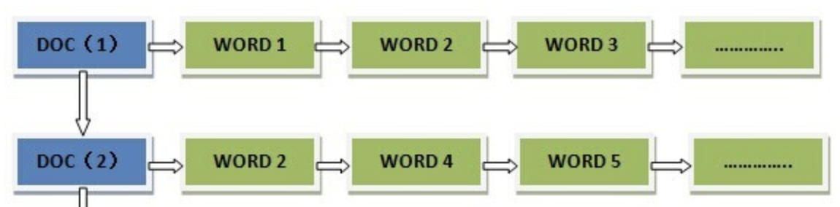
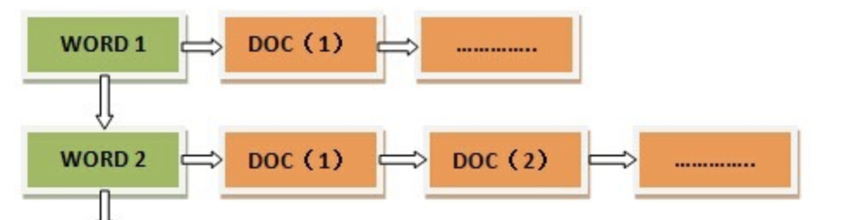
Introduction: indexing

Slide 3
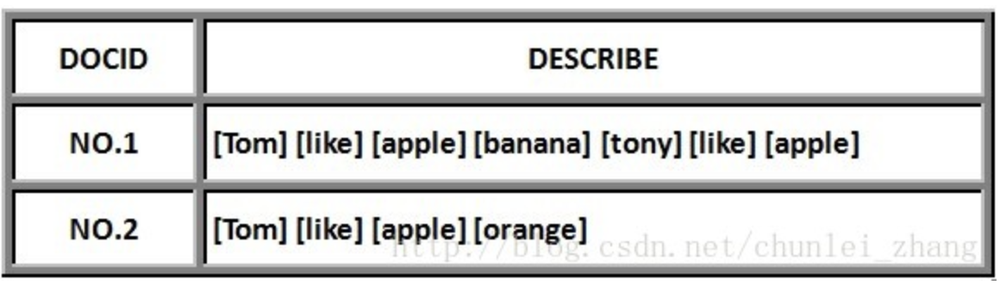
Introduction: forward

Slide 4
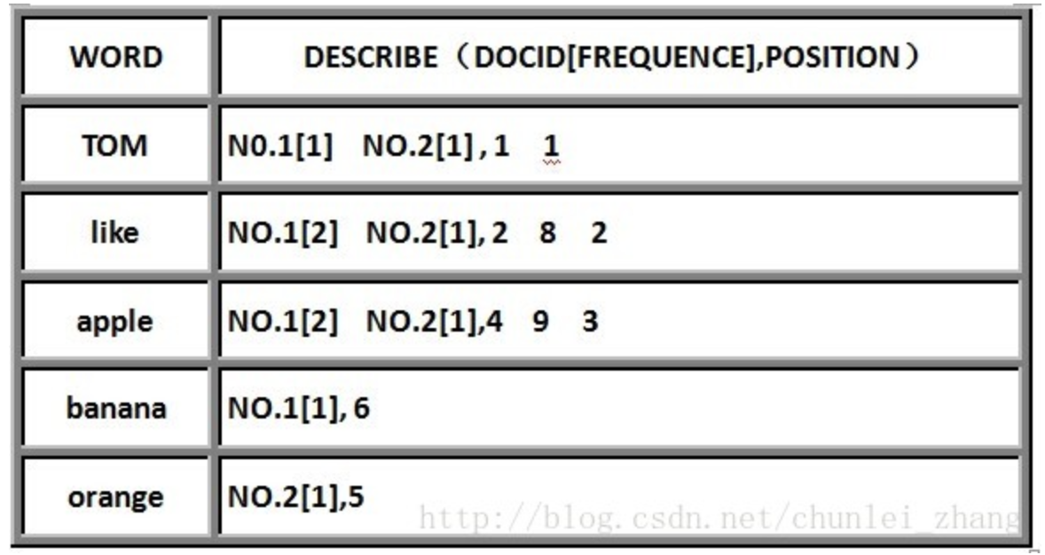
Introduction: inverted

Slide 5
Introduction: Apache Lucene
Text Analysis and Compress
Scalable, High-Performance Indexing
IndexReader/ Searcher

